Slide 1
Notes:
INTERNAL NOTES
This presentation is meant to serve as the baseline overview of LHM.
Please use this in any instances where we are introducing or updating our constituents: donors, LLL members, churches, pastors, ambassadors, other volunteers, board members, new staff, etc.
The ‘run time’ for this deck (37 slides) is about 45 minutes. It can be edited based upon audience and available time frames.
Use the embedded notes as you see fit. They are not mandatory and not meant to be read word for word – they are meant to provide additional details as you consider how to communicate each slide. Some slides are self explanatory.

Slide 2
(INSERT NAME)
(INSERT TITLE)
(INSERT DATE)

Slide 3
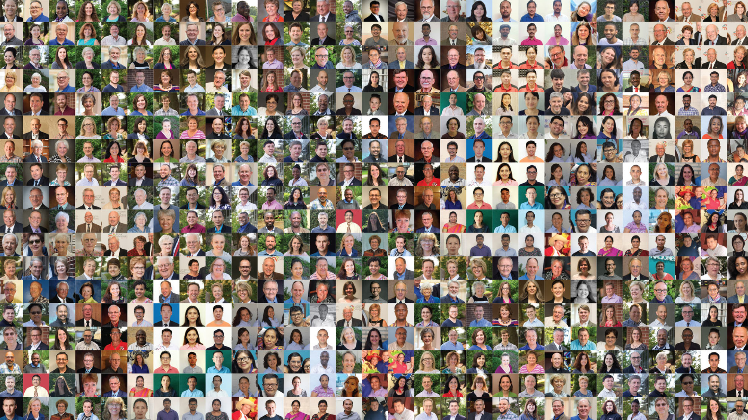
Notes:
What do you see when you look closely at this picture?

Slide 4
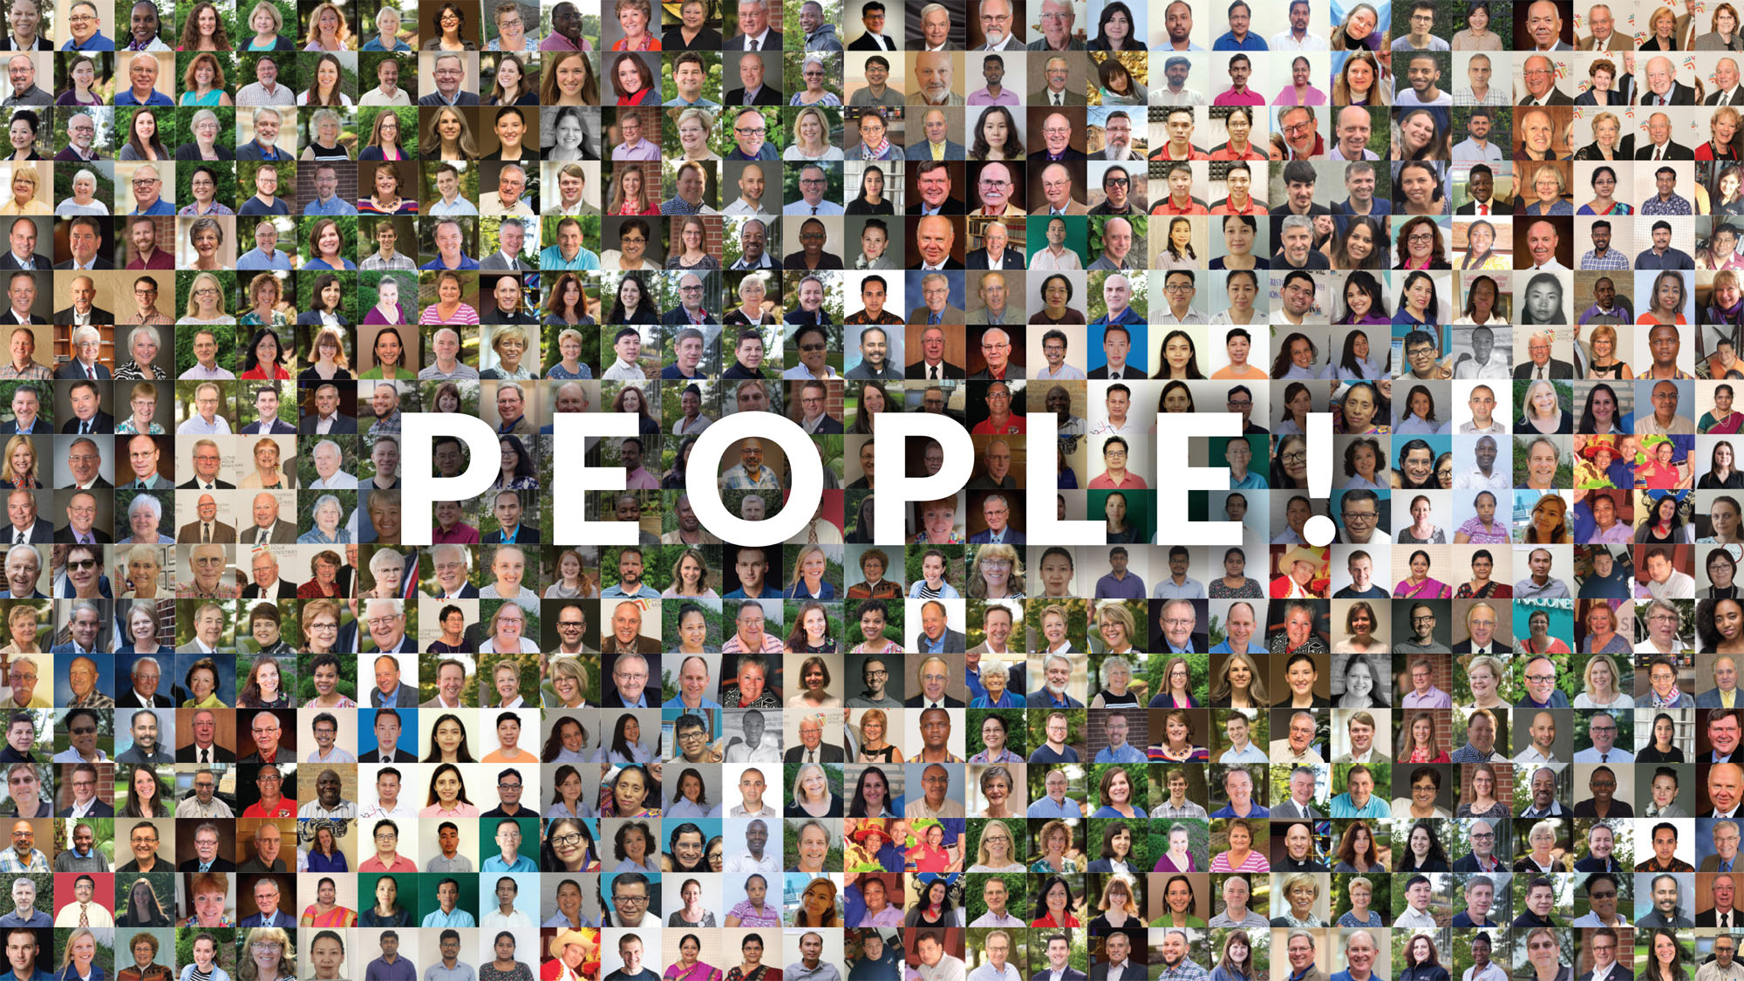
Notes:
PEOPLE! These are real people who are serving our church through the mission and ministry of LHM. When you look closely you can see the faces of ministry. From staff in St. Louis, to ministry center directors around the world, to volunteers who support us in mission, this mosaic of faces speaks to the focus of LHM and our call from Christ to spread the Gospel.

Slide 5
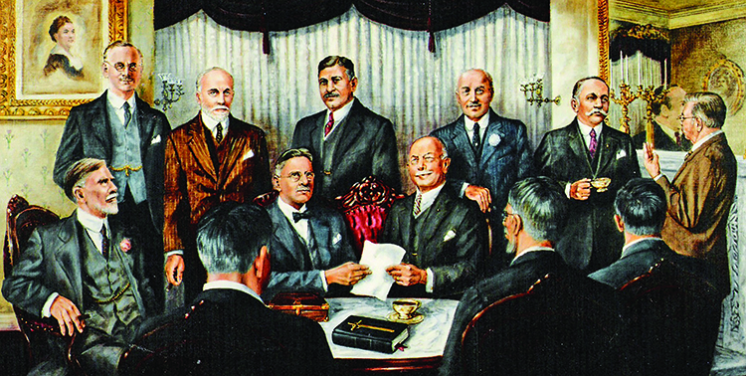
Notes:
In 1917, 12 laymen came together to help solve a challenge facing the LCMS church body. They were able to address that challenge and from that initial beginning launched what is now called Lutheran Hour Ministries. What started as 12 has grown to a global ministry with a mission and vision to reach the lost.

Slide 6
100+ YEARS OF MISSION AND MINISTRY
Notes:
Throughout our history, the organization has met people where they are to share the Gospel. From radio in the 1930s to television in the 1950s to digital outreach today, our ministry has leveraged the latest in communications technology to share the Good News with as many people as possible.

Slide 7
OUR WORLD NEEDS THE GOSPEL
More than three billion people have yet to hear the saving message of Christ.
Technology allows us to engage with others more efficiently and effectively than any other time in history, especially as people crave a relationship with God and each other.
We can use our gifts to make a real difference right where we are. Our faith, put into action on a local level, can make an immediate and personal impact in our neighborhood and beyond.
Notes:
Today, it’s more important than ever to reach out in relevant ways to a broken world with the hope of the Gospel. We live in a time of opportunities:
More than three billion people have yet to hear the saving message of Christ.
Technology allows us to engage with each other more efficiently and effectively than any other time in history, especially as people crave a relationship with God and each other.
We can use our gifts to make a real difference right where we are. Our faith, put into action on a local level, can make an immediate and personal impact in our neighborhood and beyond.
The need for bold proclamation of Christ’s love has never been greater!

Slide 8
OUR MISSION & VISION
Mission Statement
Bringing Christ to the Nations—and the Nations to the Church Vision Statement
Every person has the opportunity to hear the Gospel in an understandable way;
Those seeking are connected to a healthy Christian community where they can grow in their faith;
Every Christian is equipped to share the Gospel in word and deed;
Engaged Christians advance this common mission as a global community.
Notes:
The Lord has placed Lutheran Hour Ministries in a unique position to respond. Lutheran Hour Ministries is a trusted resource in mass media proclamation with a global network of partners. Lutheran Hour Ministries carries out its mission of Bringing Christ to the Nations—and the Nations to the Church by developing culturally relevant programs and projects that proclaim the Gospel to the unchurched. We then encourage these people who are reached to respond by contacting staff or volunteers. We cultivate relationships with those who have responded to ultimately facilitate a relationship between them and a welcoming Christian community, thus helping grow the Kingdom of God.
LHM has established a bold vision to work together to share the love of Christ to the world. While God’s work on the human heart can never be measured, we will not rest until…
Every person has the opportunity to hear the Gospel in an understandable way;
Those seeking are connected to a healthy Christian community where they can grow in their faith;
Every Christian is equipped to share the Gospel in word and deed; and
Engaged Christians advance this common mission as a global community.

Slide 9
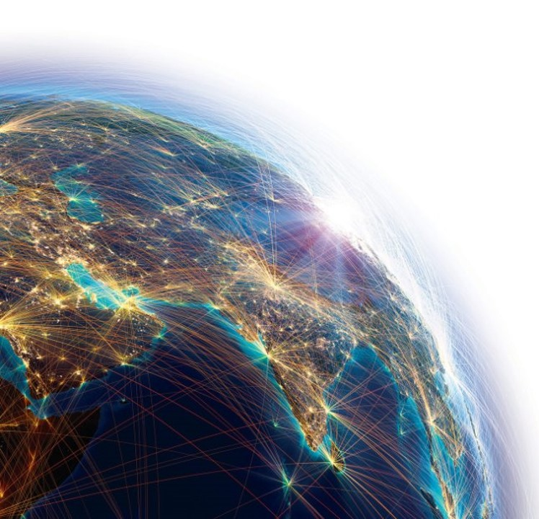
Notes:
How do we connect and share the hope of the Gospel with so many who have never heard the Name of Jesus? Lutheran Hour Ministries (LHM) believes we are called, equipped, and sent to CONNECT people with the Gospel yesterday, today, and into the future.
Building upon the success of the SENT Initiative that nearly tripled the number of times LHM reaches people with the Gospel each week, CONNECT is a crucial next step forward in achieving our shared mission that is fueled by the generous leadership and support of God’s people like you! The urgency of the Gospel is real, and the time to act is now. CONNECT is a bold multi-year initiative to ignite a movement throughout the Christian church that empowers Christians to use their unique gifts for sharing the Gospel in word and deed.

Slide 10
ACCOMPLISHMENTS THROUGH CONNECT
Notes:
Since CONNECT was quietly launched in 2020, we have achieved several ministry milestones to reach more people with the Gospel, including:
PAK7 satellite television partnership
New programs and materials generated from our partnership with Barna Group
Launch of the Gospel Adventures Show audio program for children
New ministries started under the International Internship Program

Slide 11
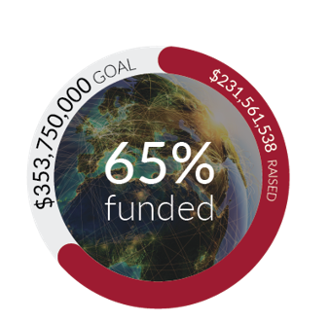
A GROWING GOSPEL IMPACT THROUGH CONNECT
Notes:
We’ve set some big goals for what we’ve already started and what we still intend to do. As a ministry goal, we are going to increase our reach around the world to 375 million Gospel touches each and every week. To do that and much more, our intention is to raise $353 million to fund this initiative to expand the ministry of LHM globally.
The most important goal through CONNECT is to reach more people with the Gospel message. Thanks to all the work we’ve done, and with the Holy Spirit, we are now reaching people nearly 235 million times each week with the Gospel message. So, we are well on the way to reaching our goal. Praise the Lord for that! A secondary goal for CONNECT was of course financial support. We are excited to announce that we have raised nearly two-thirds of our total goal. Financial support of CONNECT means more people reached with the Gospel.

Slide 12
REACHING PEOPLE WITH THE GOSPEL
Impacting People Globally
Impacting People Through Digital Engagement
Impacting People Right Where They Are
Notes:
We know our work is not done because God wants our reach to increase even further. CONNECT is supporting our vision for the future and Christ’s call to reach the world with the hope of the Gospel under three priorities: impacting people globally, through digital engagement, and right where they are.

Slide 13
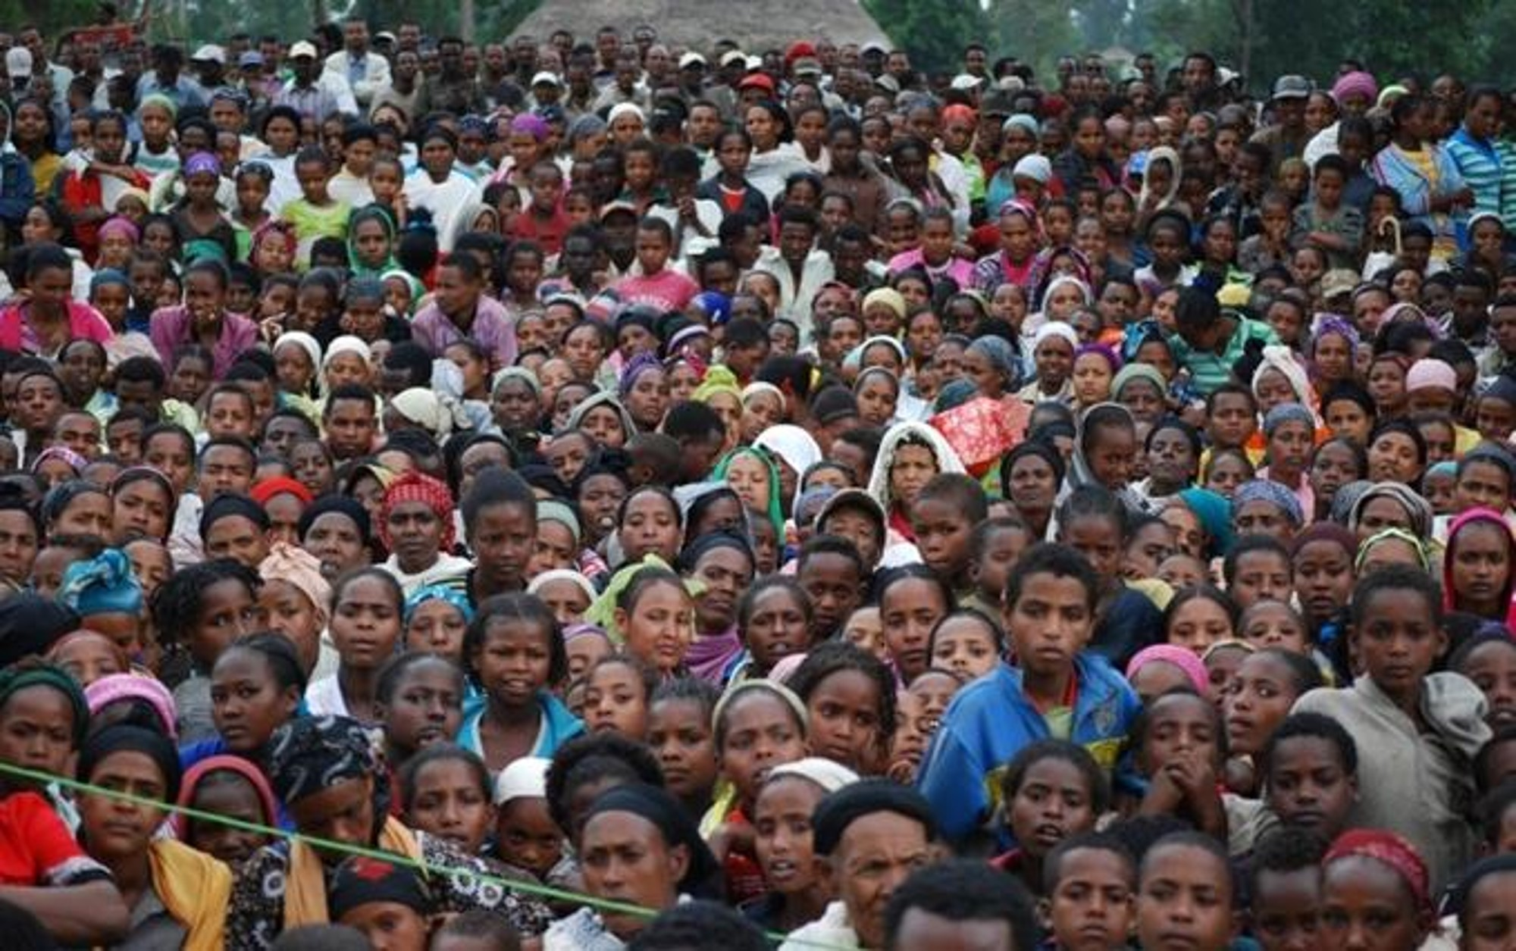
Impacting People Globally
Notes:
God has called LHM to proclaim the risen Savior around the world to reach the billions of people who still don’t know Him. people. Operating as a global ministry network, LHM spreads the Gospel in places where other Christian evangelistic organizations often cannot go, reaching all people who need to hear the Good News. We are embarking on a bold globalization initiative over the next five years that will allow us to exponentially expand our ministry work into places that we have not yet had an opportunity to explore

Slide 14
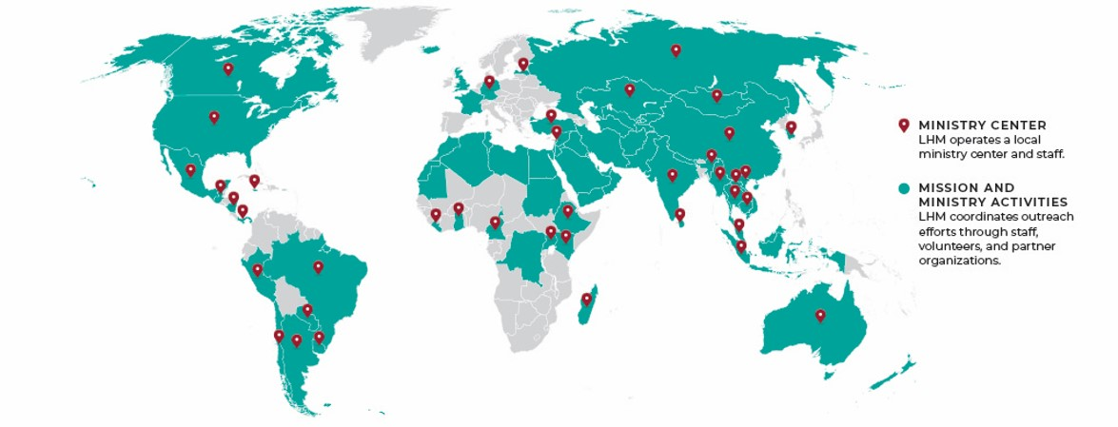
OUR GLOBAL FOOTPRINT
Notes:
LHM began its global ministry work in 1940 with the distribution of The Lutheran Hour to the Philippines. Those early experiences deepened our desire to go further and create a model for ministry that we continue to use today. LHM uses locally established ministry centers in more than 30 locations to share the Gospel with people in more than 60 nations around the world. Modern communication tools offer the potential to proclaim the Gospel to every unreached person on the planet. LHM is poised to do just that—to expand global outreach to the furthest corners of the earth.

Slide 15
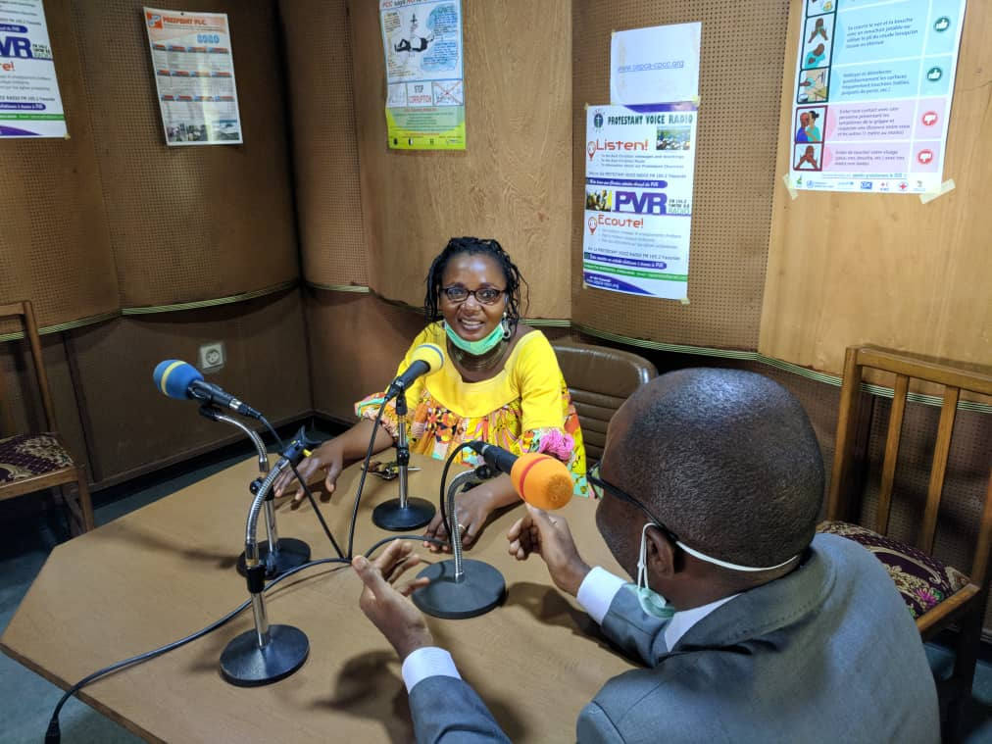
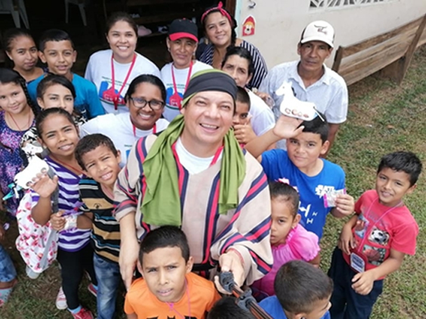
UNIQUE MINISTRY MODEL
Equips local staff and volunteers
These individuals know the language, understand the culture, and can most effectively communicate the Gospel in their context
Ministry centers customize outreach programs and resources to the needs of local people and begin establishing more personal relationships
Notes:
But how can we reach so many and speak truth when we may not even speak the same language? LHM has developed a unique approach: from the inside out. Many ministries send people to other countries with messages that have been developed in the western world and simply translated into local languages. Often, even if translated, those messages do not touch the hearts of the people from other cultures because they are not contextually appropriate. The people often cannot relate to the examples and stories used, meaning the issues or problems they are dealing with are not appropriately addressed.
LHM’s global ministry model is different from most mass communications ministries. LHM lifts up and equips local staff and volunteers who know the language, understand the culture, and can most effectively communicate the Gospel in their context.

Slide 16
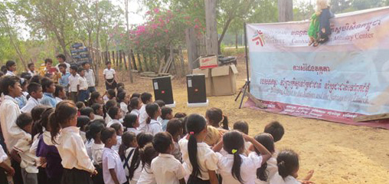
CULTURALLY RELEVANT PROGRAMMING
Radio and TV Broadcasts
Print, Audio, and Digital Materials
Bible Correspondence Courses
Rallies
Dramas and Puppet Ministry
Youth Programs
Vocational Skills Training
Holistic Outreach
Notes:
LHM’s programming and resources are created locally, ensuring maximum impact and accuracy of the message of the Gospel. Our staff members grew up speaking the languages they do outreach in and know the culture intimately as an insider. As local people, they are particularly well qualified to know how to communicate the Gospel effectively in their context. They understand the linguistic and cultural nuances that are essential to effective and accurate communication, especially when it comes to something as important as the life-transforming message of the Gospel.
Since the staff members are from that culture and understand the local needs, LHM can customize our outreach to the particular issues that people are facing and begin establishing a more personal relationship. By identifying, developing, and using resources in local languages that are culturally relevant and attractive, LHM staff seeks to proclaim the hope and salvation found in the Word of God by reaching out to people of all nations and building trust with those individuals to connect them in fellowship to a local Christian community. These programs and resources include radio broadcasts and spots, television programming, digital outreach, puppet ministry, rallies, Bible Correspondence Courses, holistic outreach, print and audio materials, and much more, that most effectively reach the intended audience.

Slide 17
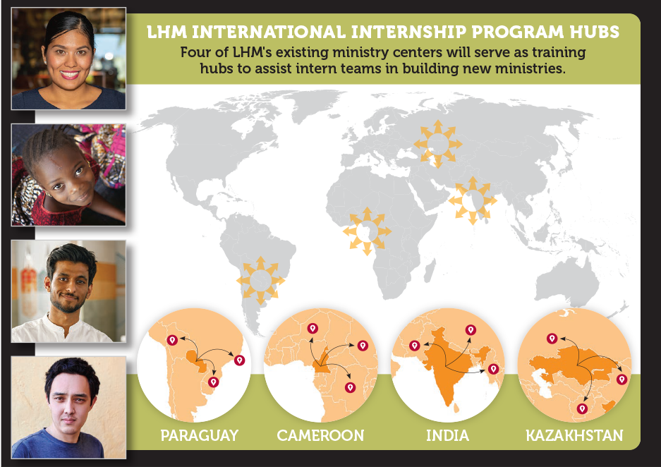
INTERNATIONAL INTERNSHIP PROGRAM
New Ministries
Democratic Republic of the Congo
Kyrgyzstan
Nepal
Peru
Team Functions Include …
Multimedia
Social Media
Children’s/Youth
Notes:
Building upon our successful model of hiring local staff, we launched an innovative approach to global expansion last year called the International Internship Program. This program uplifts the next generation of Christian leaders to do ministry in their local context, in their native language, in a very specific way. This will lead to us hiring and equipping intern teams for ministry in 12 new areas over a three-year period. Working through four existing ministry centers, intern teams with three individuals each have completed their training and started ministry in Peru, Nepal, the Democratic Republic of the Congo, and Kyrgyzstan. Starting out, we will have a group of three paid interns on each team that works with one of our four training hubs: a person focusing on programming, a person focusing on social media, and a person focusing on audio and visual media. The programming person will concentrate on the development of children’s ministry, the digital person will create the website and social media platforms, and the audio/visual person will develop the content to be used in face-to-face ministry activities and on social media platforms. One of the three interns will also assume the responsibility of team lead to oversee administration, management, and fund development functions for the new ministry.
We look forward to beginning the training cycle for four new countries this fall.

Slide 18
Impacting People Through Digital Engagement
Notes:
The world today is increasingly shaped and connected by the internet. As people become more present online, God’s people are finding ways to share the Gospel in this space. LHM is once again a pioneering force for good in this realm as we proclaim the Name of Jesus to people around the world. We are eager to engage in this place at this time because never before has the opportunity existed to reach the entire world with the Gospel. LHM maximizes its online presence today to share the Good News through a variety of platforms and rapidly increase the capacity for the priesthood of all believers to connect more souls to the saving message of Christ.

Slide 19
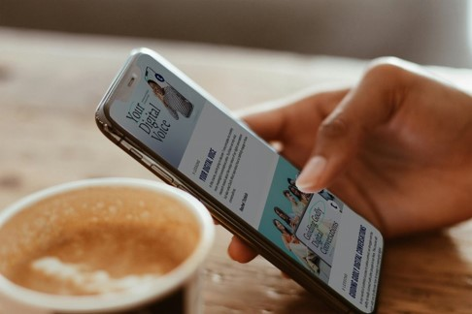
Inspiring and equipping every Christian to share their faith through winsome digital interactions that lead to meaningful spiritual conversations.
Notes:
LHM’s digital outreach platform, Thred at thred.org, introduced a fresh look and refined vision last year. While its focus on encouraging an open and honest conversation about life, faith, and Jesus has not changed, one of its main objectives is to help you discover how to integrate your faith into your online presence. Thred offers blogs, courses, downloadable resources, and much more through its website and social media platforms to take you deeper into the art of spiritual conversations, giving you practical tips and tools to share your story of hope and better connect with others. Visitors to the website can share ideas and learn from others who are creating authentic, relevant, and meaningful digital experiences. They can also sign up to have content delivered straight to their inbox.

Slide 20
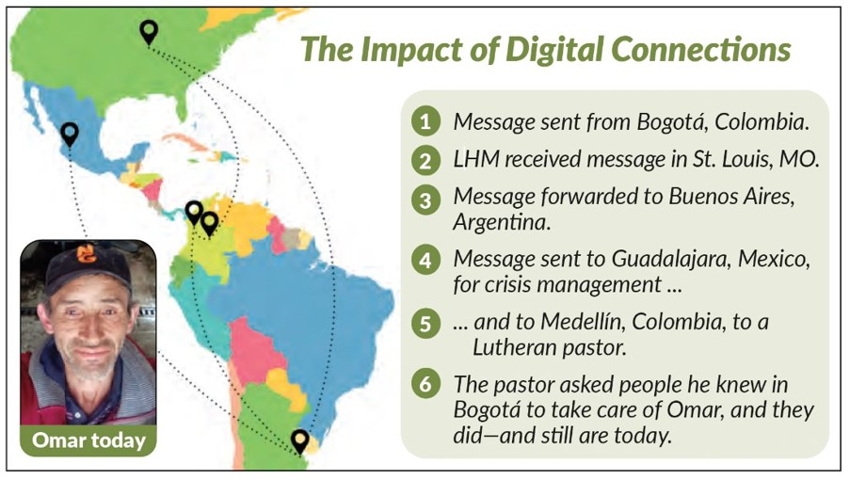
Notes:
The following story highlights the global, yet personal way one-on-one ministry is happening through LHM’s ministry efforts in Latin America.
Omar from Bogotá, Colombia, was suicidal when he came across LHM’s Para el Camino
website and reached out to LHM staff on Facebook Messenger. He made text contact with
Beatriz Hoppe, our recently retired coordinator for Hispanic ministry at LHM. The rest is about networks and relationships. Hoppe contacted Pastor Fester from LHM–Argentina. He coordinates volunteers through Vivenciar.net, a digital platform offering relevant topical content for Portuguese- and Spanish-speaking individuals. Fester contacted Julyssa, a counselor with LHM–Mexico. She called Omar
for more information and crisis management. Fester then called Pastor Marín in Medellín, who
connected with a colleague in Bogotá who—per Julyssa’s recommendations—located Omar and got him help at a medical clinic.
Once on the ground with Omar, this distraught man was encouraged to receive the care he
needed. He is now regaining his physical and emotional health and has found employment.
He passed this note on to those who helped him: “Thanks to God and to you. This is what I can now do with great love.”

Slide 21
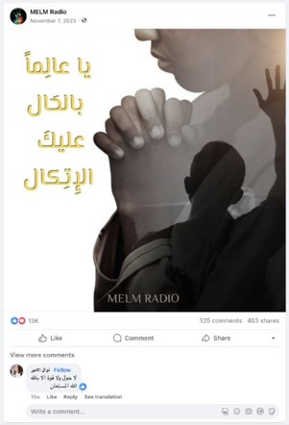
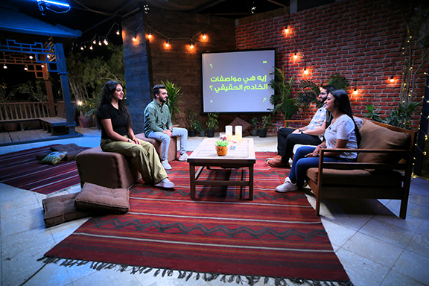
MIDDLE EAST & NORTH AFRICA
Reaching Millions in 20+ Countries Through …
Social Media Outreach
Radio Broadcasts
Satellite Television Partnerships with SAT-7 and PAK7
Notes:
People throughout the Middle East and North Africa constantly search for hope and peace for their lives that are often filled with emptiness. Over the past several years, LHM has partnered with SAT-7 to produce satellite TV programming that shines the light of Christ into more than 20 countries throughout the region. Many viewers reach out through social media
following the broadcasts seeking more information about what they heard and how it can provide comfort and hope for their lives. A fifth season of supporting Arabic-language programming through SAT-7 launched with a new program, titled Catalyst, that engages young adults by fostering dialogue about topical issues relevant to the people living there. The success of the Arabic programming has led to support of programs with SAT-7 PARS for Persian-speaking children, youth, and women throughout Central and West Asia and PAK7 for Pakistani children. Many viewers watching these broadcasts hear about Christ for the first time or have incorrect knowledge about Christianity.
Millions of people in the Middle East and North Africa are also reading LHM’s inspiring messages and watching our topical video content across four social media sites. Over the past several years, nearly 1.5 million people from throughout the region have responded by subscribing to these pages, where they are gently led towards spiritual conversations. LHM staff has had conversations with tens of thousands of these individuals where they shared the message of God’s hope and love for their lives. One of the pages just surpassed one million unique followers.

Slide 22
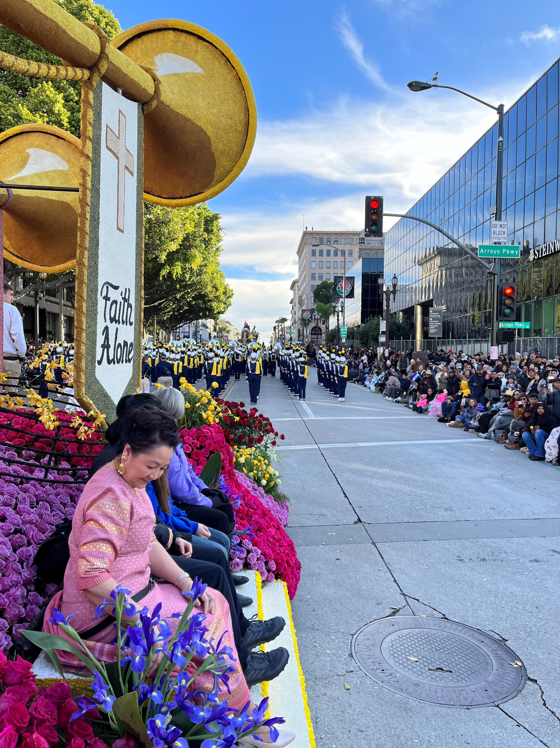
Impacting People Right Where They Are
Notes:
What if every Christian saw his or her neighbor as a gift from God with gifts to share? How would that change how we view, interact with, and serve our neighbors? During a time when people are searching for hope, community is more important than ever. LHM is answering the question, “How can I bring hope to my neighborhood?” We can use our individual gifts to make a real difference right where we are, among the neighbors we know and those we have not yet met but see every day. If history is an indicator, God could use our good deeds to gain a hearing for the Gospel and, according to His will, draw our non-Christian neighbors to the faith. This concept is really nothing new for us at LHM. Gathering at the local level and building genuine relationships with people close to us have been in LHM’s DNA since our inception more than a century ago. This 21st century approach brings people together while sharing the Gospel both in word and deed. Understanding our giftedness and using those gifts to bless others can build strong connections with those around us. It is exciting to think about the impact of millions of Christians loving their neighbors. Together, we can make it a reality.

Slide 23
THE UNITED STATES MISSION FIELD
Notes:
In communities across America, recent studies show that more than one quarter of adults have left the faith in which they were raised in favor of another religion or no religion at all. As these people start families of their own, the number of American children growing up in homes without God will continue to multiply. To help reverse these trends, LHM remains committed to providing tools that equip and embolden us to share the Good News with the people in our lives who do not share the Christian faith.

Slide 24
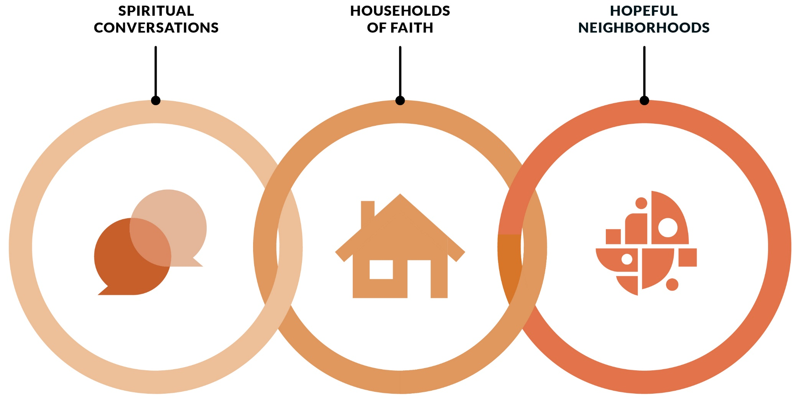
OUR OUTREACH PHILOSOPHY
Notes:
LHM has adopted a core principle that directs whatever we conceive or create to be developed in a research-based environment. In 2017, we began a partnership with the Barna Group, a world-renowned, premier Christian research firm. The resulting research findings helped form an outreach philosophy to guide our outreach initiatives. This work has informed and guided our efforts to produce thoughtful products, programs, services, and curriculum that LHM provides to its constituents largely at low or no cost.

Slide 25
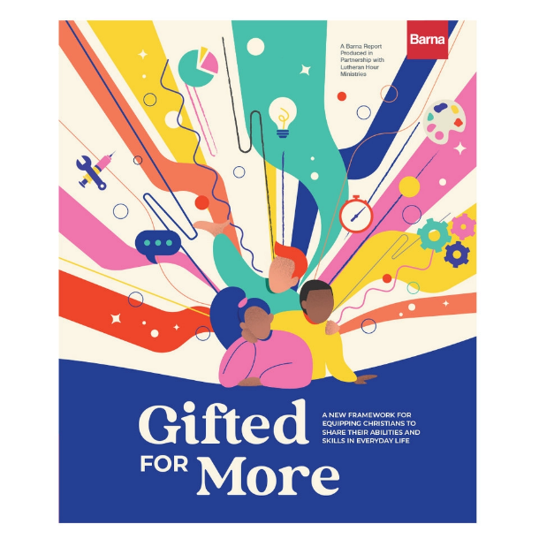
BARNA RESEARCH
Resources at lhm.org/barna
Notes:
In addition to conducting and providing groundbreaking research, Barna Group has created a yearly monograph for Church leaders containing data, analysis, and relevant insights. LHM has created products and programs designed to take what is learned directly to congregations and individuals to apply the new insights in their outreach efforts. This timely research has allowed LHM and Barna to equip the Church to share the hopeful Gospel message, deepen faith in households, and impact neighborhoods with the Good News of Jesus Christ. We are excited that Outreach Magazine named the Spiritual Conversations in the Digital Age monograph as the Resource of the Year for Evangelism in its March/April 2019 issue of the magazine. The acknowledgement of our research by a widely respected Christian publication like Outreach is a testimony to the timeliness of the research as well as its relevance to a wider Christian audience. Our newest research topic offers the U.S. Church a fresh framework for giftedness. This report follows Christians through phases of their own journey: from being aware of their gifts, to being intentional with their gifts, to being generous with their gifts. Are you curious about the aptitudes, innate abilities, and acquired skills that make you unique? Take the EveryGift Inventory to see your gifts in 12 distinct areas. Visit everygift.org.

Slide 26
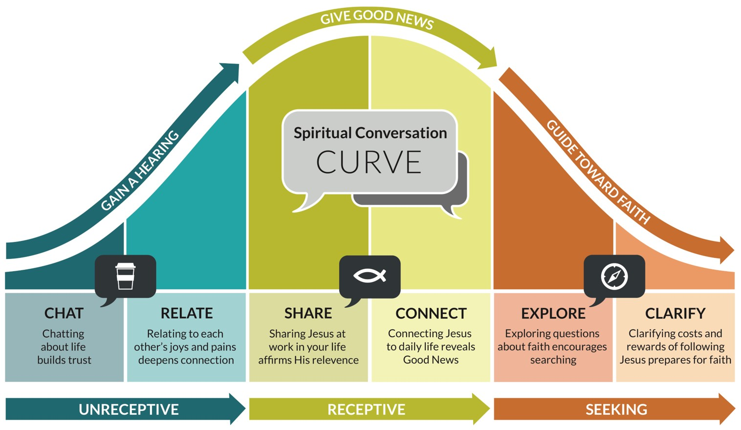
A MODEL FOR SHARING THE GOSPEL
Notes:
Based on the initial round of research findings, LHM set out on a mission to find a practical way to equip Christians for spiritual conversations. This desire to equip the church led to the careful development of a practical new tool for reluctant conversationalists: The Spiritual Conversation Curve. This conversation model is simple, but not simplistic. The curve illustrates the relationship between three important questions:
What is the spiritual posture of the person I want to talk with?
How can I be in prayer for them given their spiritual posture?
What type of conversation would be most fruitful to pursue?
Relative to the Christian faith, there are actually three basic spiritual camps in our culture today: those who are unreceptive to Christianity, those who are receptive to Christianity, and those who are seeking clarity about Christianity. You can see these three basic camps along the bottom of the Spiritual Conversation Curve. The corresponding prayerful responses to each posture (gain a hearing, give good news, and guide toward faith) can be found in the arrows along the top of the curve.
But what do you actually talk about? Notice the six different conversation types found at each point along the curve. Each distinct conversation type is helpful, but it’s the spiritual posture of the non-Christian that determines when each type of conversation is most helpful. Knowing where someone is in their spiritual journey helps you discern whether it is most helpful to chat, relate, share, connect, explore, or clarify.

Slide 27
OUR NEWEST RESEARCH-BASED RESOURCES
Five-session Bible study focused on the gifting of veterans and how they see their gifts being used beyond the military.
Seven-lesson course to help high school-aged students recognize and respond to opportunities for having spiritual conversations.
Notes:
We have just released two new resources based on the Gifted for More and Spiritual Conversations research findings. Called to Serve: Utilizing Our Gifts As Veterans is a five-session, video-based Bible study written specifically for veterans. It focuses on the gifting of veterans and how they see their gifts being used beyond the military. The study includes a leaders guide with details on planning and hosting meetings, pointers for group leaders, tips on coordinating tasks with volunteers, and a friendly reminder to rely on the Holy Spirit’s guidance and direction. Each session has instructions for room setup, a scripted opening and prayer, meal-time questions, post-video questions, a closing, and a call to action. Each video features comments from hosts and veterans, with each sharing their perspective on topics like giftedness, leadership, utilizing one’s gifts outside of the military, being a mentor, and the importance of mission in civilian life.
Spiritual Conversations: Sharing Life, Faith, and Jesus with Friends is a seven-lesson course designed for teachers and youth leaders to help high school-aged students recognize and respond to opportunities to have spiritual conversations. Lessons can be presented daily, weekly, or even monthly, depending on the context and schedule of the group. This course includes interactive group activities, videos, data to consider, opportunities for discussions on Scripture and faith-sharing conversations, and more.

Slide 28
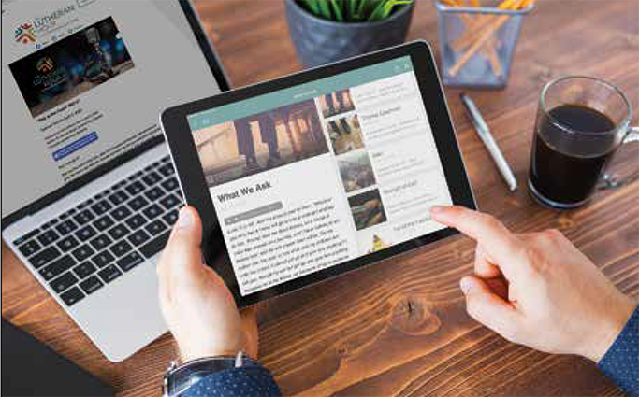
SPIRITUAL GROWTH AND EQUIPPING RESOURCES
Radio Broadcasts
Podcasts/Apps
Devotions
Topical Studies
Printed and Audio Booklets
LHM Learn
Gospel Adventures
The Hopeful Neighborhood Project
Notes:
We offer a multitude of additional resources, from our flagship radio broadcast to devotions and from topical studies to online Bible studies and courses, that are designed to reach people at various stages of their faith journey and to help them more effectively share the Good News with people in our lives who don’t share the Christian faith.

Slide 29
GOSPEL ADVENTURES SCHOOL PROGRAM
Notes:
Our annual Gospel Adventures interactive experience includes a daily curriculum, videos, theme music, maps, colorful graphs and charts, hands-on activities, identification boxes, questions for discussion, and more—all working together to showcase the highlighted country's religion, ethnic groups, ways of living, culture, customs, and history. By the end of the journey, participants will possess a deeper understanding of the work of the Gospel in their own lives and how God is at work in people’s lives in this exciting part of the world. And best of all, this five-day adventure is completely FREE!
While it originally rolls out and is widely used annually during National Lutheran Schools Week in January, this program is available to be used anytime throughout the entire year by individuals and schools. It has been a hugely popular resource for home schools and children studying virtually from home. Around 40,000 elementary and middle school students typically participate in the program each year, but the experience offers something for people of all ages. There is still time to participate in our 2024 “trip” to Australia; visit gospeladventures.org. Stay tuned for more information coming soon about our 2025 “trip” to Kenya!

Slide 30
GOSPEL ADVENTURES SHOW
Weekly program for kids that is available as a podcast and more than 50 stations across the United States
Through Bible Stories, songs, storytelling, and activities, kids will encounter clear and compelling Gospel themes
Season two begins this fall
gospeladventures.org/show
Notes:
Building on the popularity of the classroom experience provided by Gospel Adventures, LHM teamed up with Group Publishing to launch a new weekly audio program for kids. The Gospel Adventures Show is available online at gospeladventures.org/show or wherever you listen to podcasts. It also airs on more than 50 radio stations across the United States.
Through Bible Stories, songs, storytelling, and activities, kids will encounter clear and compelling Gospel themes. Join our hosts, Ben and Noah, as they teach listeners about Jesus and His love for us!

Slide 31
THE HOPEFUL NEIGHBORHOOD PROJECT
Award-winning, collaborative network committed to improving neighborhood well-being around the world
Resources and online network equips and encourages neighbors to work together, using their gifts and the gifts of their community, to pursue the common good of their neighborhood
hopefulneighborhood.org
Notes:
Drawing from insights learned from the Better Together research in partnership with Barna Group, LHM established The Hopeful Neighborhood Project. The Hopeful Neighborhood Project is a collaborative network committed to improving neighborhood well-being around
the world. Our resources and online network equip and encourage neighbors to work together, using their gifts and the gifts of their community, to pursue the common good of their neighborhood. At LHM we’ve identified three important steps toward healthier, more hopeful neighborhoods. First, discover the gifts. Second, imagine the possibilities. And third, pursue the common good. When put into action, these steps can help us make real connections with our neighbors, increase neighborhood well-being, and work toward a world where all people experience the love of Jesus.
The Hopeful Neighborhood Project and its program partner, University of Missouri Extension, were honored with the Best Neighborhood Program award during the 2023 Neighborhoods USA (NUSA) conference for their work on Missouri Good Neighbor Week. During the 2022 Missouri Good Neighbor Week, there were 12,854 documented acts of neighboring in 63 counties, 11 individuals and groups recognized for the best acts of neighboring statewide, and 10 people nominated as the Most Engaged Neighbor in Missouri. Missouri is the only state to celebrate neighboring for an entire week after the governor signed it into law.
For more information, visit hopefuneighborhoods.org.

Slide 32
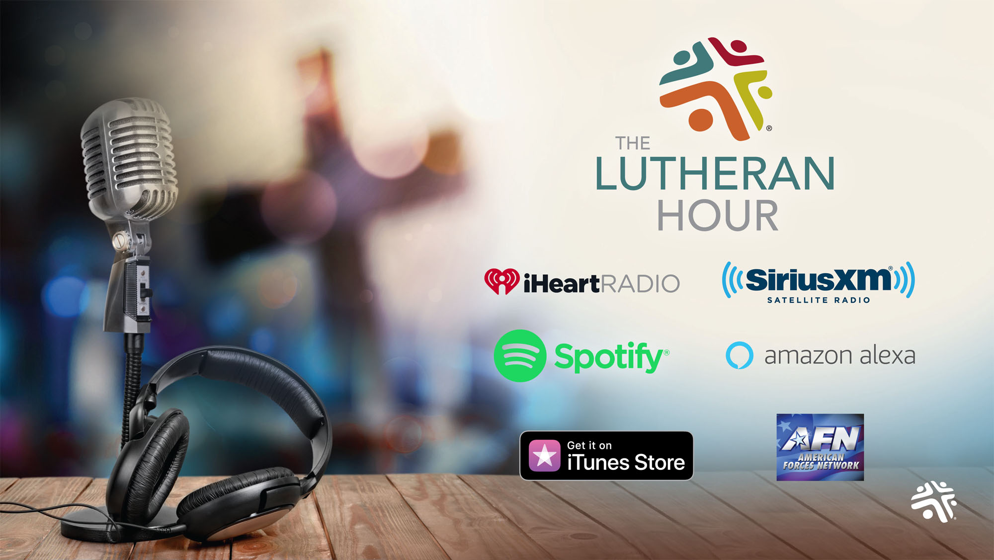
Notes:
As the longest running Christian outreach radio broadcast, The Lutheran Hour continues to expand its reach here in the United States – it is currently broadcast each week through airings on around 1,700 radio stations throughout North America as well as the American Forces Network. The program is also available as a podcast and on several new media platforms, including:
Amazon Alexa, a voice-activated assistant to play media programming;
Spotify, an on-demand media streaming service;
iHeartRadio, a free broadcast and internet radio platform; and
SiriusXM Satellite Radio’s Family Talk Channel 131 at 10 a.m. EST every Sunday.
In addition to the weekly broadcasts, special programs are now being offered each year for Easter and Christmas.

Slide 33
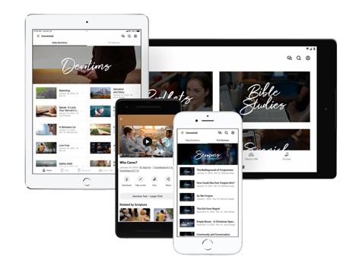
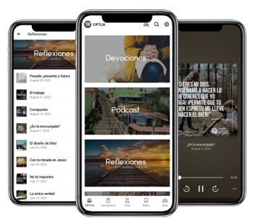
THERE’S AN APP FOR THAT!
Connected by LHM
Daily—and Seasonal—Devotions
The Lutheran Hour
Topical Bible Studies
Project Connect Booklets
CPTLN
Para el Camino
Daily Devotions
Sentido Latino Podcast
Bible Studies
lhm.org/apps
Notes:
Another of these new media platforms offering LHM programming are the apps available for Apple, Android, and Kindle devices. Check out the following apps:
Connected by LHM App LHM Daily (and Seasonal) Devotions
Inspirational Scripture-based messages are available at your fingertips every day (and also through a daily email). Read the devotion text, listen to the audio version, or share the devotion with a friend. Season-themed devotions during Advent and Lent are also available.
The Lutheran Hour
Play the audio or read the text of the program's current sermon, search and play a sermon from The Lutheran Hour archive, or learn about the program’s Speakers through the years.
Video Bible Studies Have immediate access to award-winning, original Bible studies with streaming video, study guides, downloads, and more.
Project Connect As a topical booklet ministry, Project Connect is an excellent evangelism resource. It gives congregations and individuals an outreach program that works and is easy to maintain. This app not only allows you to download and share these great resources, but to listen to high quality recordings as well.
CPTLN APP This app, full of resources created for Hispanics by Hispanics, offers a convenient way to connect Hispanics to Jesus and equip them to share the Good News of the Gospel with others. This app is a mobile hub for all our Spanish resources, including Para el Camino, Sentido Latino, audio files, Daily Devotions, seasonal devotions, The Lutheran Hour sermons, sermon notes, Project Connect booklet PDFs, Bible studies, reflections, Vivenciar.net, a Bible app, and a chat function.

Slide 34
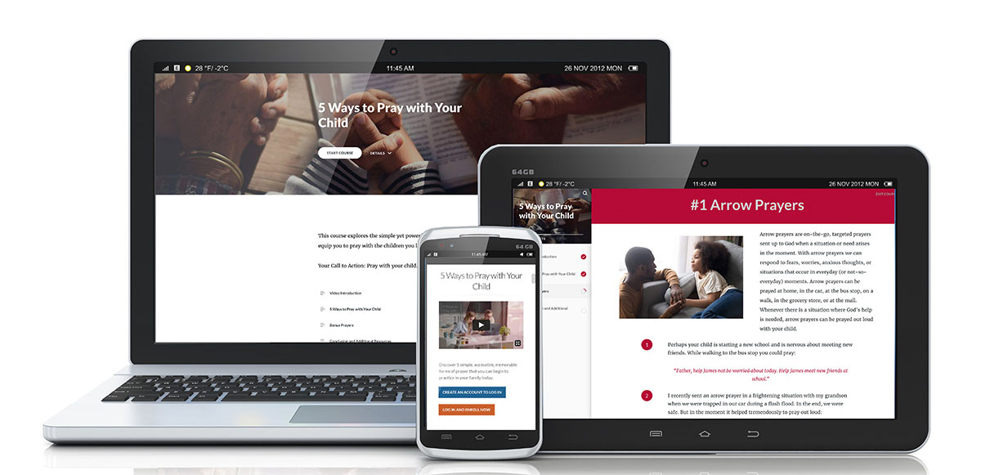
LHM LEARN
Online system of outreach courses using an array of multimedia elements to help users gain a hearing for the Gospel
More than three dozen courses available across five faith-strengthening categories
lhm.org/learn
Notes:
Acutely aware of the need for people to share their faith in a way that’s sensitive to others and mindful of circumstances, LHM offers an online learning system of outreach courses called LHM Learn. These online courses and webinars cover five faith-strengthening categories and use an array of multimedia elements to help you gain a hearing for the Gospel message.
Christian Foundations explores the basics of Christianity from biblical, theological, and historical perspectives;
Cultural concepts helps understand different demographics, cultures, and religions in our world today;
Everyday insights provides thoughts and the good and bad that life throws at us;
Outreach essentials equips for personal evangelism and provides tools to reach others with the Gospel;
Spiritual reflections are devotional thoughts meant to strengthen and encourage
Courses often feature a downloadable journal, discussion guide, videos, Scripture passages, outreach scenarios, and more. A short quiz tops off each course and reinforces the materials studied.
Check out lhm.org/learn today.

Slide 35
MINISTRY IMPACT
Notes:
LHM takes seriously the need to measure our global impact for the sake of good stewardship and ability to truly make the greatest difference.
In 2015, LHM embarked upon SENT, a bold initiative that sought to clarify and communicate LHM’s vision and strategic plan to advance our mission. At that time, we were sharing the Gospel around 51 million times each week. It is with gratitude to God, and deep appreciation to the multitude of people who have supported our ministry efforts, that we have now more than quadrupled this number to reach people around the world with the Gospel nearly 235 million times each week! These relationships led to:
People intentionally provided contact information for follow up more than 1.95 million times last year in response to LHM’s culturally relevant outreach efforts.
LHM referred people to local churches and Christian communities for spiritual growth and nurturing more than 265,000 times last year.
More than 66,000 individuals participated for the first time last year in Bible Correspondence Courses offered by LHM ministry centers around the world.
Individuals completed an LHM ministry activity nearly 420,000 times last year that equipped them to share their faith more effectively.
We are also blessed to have around 365,000 engaged constituents, individuals who are actively connected to LHM through its resources or the sharing of their time, talent, or treasure in support of the organizational mission. While we rejoice at these blessings that God has provided to this ministry, our work is not done. LHM will not rest until every person has the opportunity to hear the Gospel in an understandable way.

Slide 36
WE ARE HERE TO HELP!
Website: lhm.org News/Content: lhm.org/ourlhm
Facebook: facebook.com/lutheranhourministries
X (Formerly Twitter): X.com/LutheranHourMin
Instagram: instagram.com/lutheranhourministries
Annual Report: lhm.org/report
Notes:
Thank you for joining us today. You can learn more about our work by visiting the online and social media addresses shown on the screen.
Does anyone have any questions?

Slide 37
THANK YOU!

